Slide 1
UNIT -3
FORMAL LANGUAGES and GRAMMARS
CSE322
Formal Languages and Automata Theory

Slide 2
Intro to Languages
English grammar tells us if a given combination of words is a valid sentence.
The syntax of a sentence concerns its form while the semantics concerns
its meaning.
e.g. the mouse wrote a poem
From a syntax point of view this is a valid sentence.
From a semantics point of view not so fast…perhaps in Disney land
Natural languages (English, French, Portguese, etc) have very complex rules of syntax and not necessarily well-defined.

Slide 3
Formal Language
Formal language – is specified by well-defined set of rules of syntax
We describe the sentences of a formal language using a grammar.
Two key questions:
1 - Is a combination of words a valid sentence in a formal language?
2 – How can we generate the valid sentences of a formal language?
Formal languages provide models for both natural languages and programming languages.

Slide 4
Grammars
A formal grammar G is any compact, precise mathematical definition of a language L.
  As opposed to just a raw listing of all of the language’s legal sentences, or just examples of them.
A grammar implies an algorithm that would generate all legal sentences of the language.
  Often, it takes the form of a set of recursive definitions.
A popular way to specify a grammar recursively is to specify it as a phrase-structure grammar.

Slide 5

Grammars (Semi-formal)
Example: A grammar that generates a subset of the English language

Slide 6
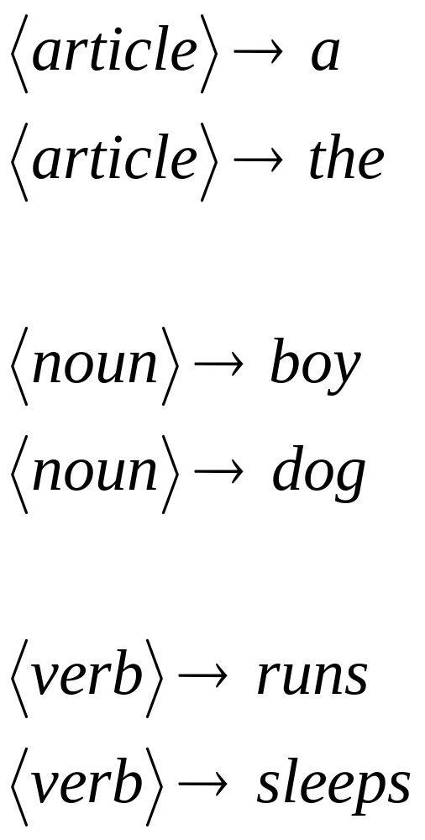

Slide 7
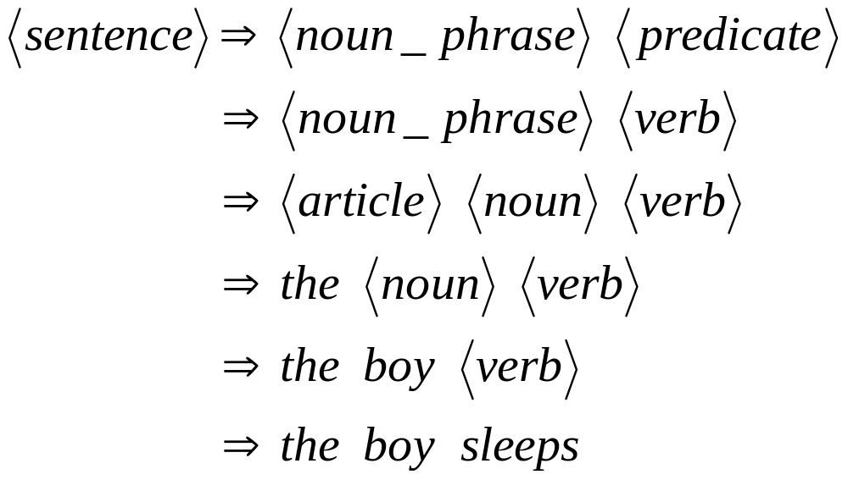
A derivation of “the boy sleeps”:

Slide 8
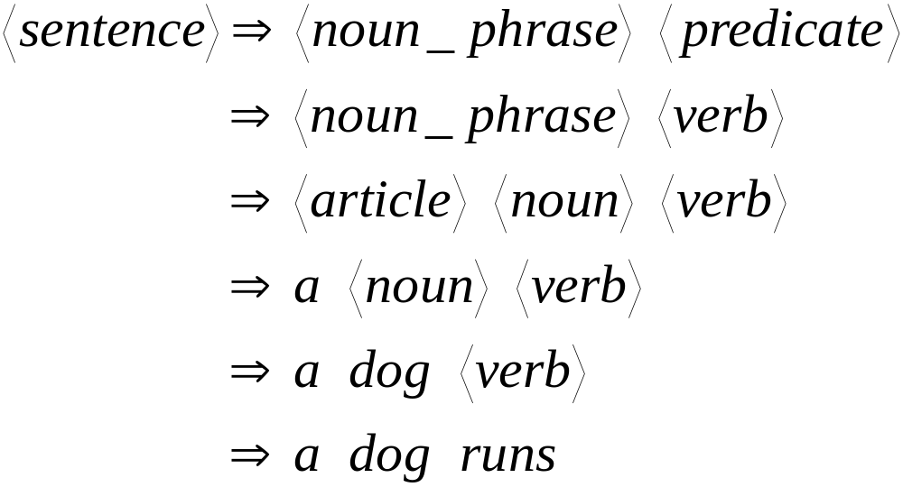
A derivation of “a dog runs”:

Slide 9
Language of the grammar:
L = { “a boy runs”,
“a boy sleeps”,
“the boy runs”,
“the boy sleeps”,
“a dog runs”,
“a dog sleeps”,
“the dog runs”,
“the dog sleeps” }

Slide 10
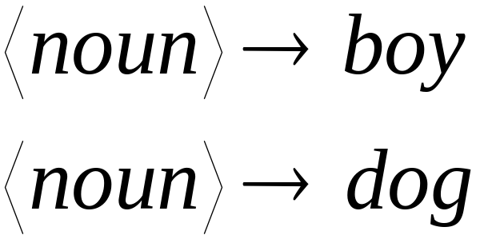
Notation
Variable
or
Non-terminal
Symbols of
the vocabulary
Terminal
Symbols of
the vocabulary
Production
rule

Slide 11
Basic Terminology
  A vocabulary/alphabet, V is a finite nonempty set of elements called symbols.
    Example: V = {a, b, c, A, B, C, S}
  A word/sentence over V is a string of finite length of elements of V.
    Example: Aba
  The empty/null string, λ is the string with no symbols.
  V* is the set of all words over V.
    Example: V* = {Aba, BBa, bAA, cab …}
  A language over V is a subset of V*.
    We can give some criteria for a word to be in a language.
Notes:
CHAPTER 5
BCT2083 DISCRETE STRUCTURE & APPLICATIONS

Slide 12
Phrase-Structure Grammars
A phrase-structure grammar (abbr. PSG)
G = (V,T,S,P) is a 4-tuple, in which:
  V is a set of nonterminals (that is represented by Upper Case).
  T is a set of symbols called terminals
  S, the start symbol.
    in our example the start symbol was “sentence”.
  P is a set of productions (to be defined).
    Rules for substituting one sentence fragment for another
    Every production rule must contain at least one nonterminal on its left side.

Slide 13
Phrase-structure Grammar
  EXAMPLE:
Let G = (V, T, S, P),
Where V={ A, B, S}
T = {a, b},
S is a start symbol
P = {S → ABa, A → BB, B → ab, A → Bb}.
    G is a Phrase-Structure Grammar.
What sentences can be generated with this grammar?
Notes:
CHAPTER 5
BCT2083 DISCRETE STRUCTURE & APPLICATIONS

Slide 14
Derivation
Definition
Let G=(V,T,S,P) be a phrase-structure grammar.
Let w₀=lz₀r (the concatenation of l, z₀, and r) w₁=lz₁r be strings over V.
If z₀ → z₁ is a production of G we say that w1 is directly derivable from w0 and we write w_{o} => w₁.
If w₀, w₁, …., w_{n} are strings over V such that w₀ =>w₁,w₁=>w₂,…, w_{n-1} => w_{n}, then we say that w_{n} is derivable from w₀, and write w₀=>*w_{n}.
The sequence of steps used to obtain w_{n} from w_{o} is called a derivation.

Slide 15
Productions
A production p∈P is a pair p=(b,a) of sentence fragments a, b (not necessarily in L), which may generally contain a mix of both terminals and nonterminals.
  We often denote the production as b → a.
    Read “replace b by a”
  Call b the “before” string, a the “after” string.
  It is a kind of recursive definition meaning that
  If lbr ∈ L^{T}, then lar ∈ L^{T}. (L^{T} = sentence “templates”)
    That is, if lbr is a legal sentence template, then so is lar.
    That is, we can substitute a in place of b in any sentence template.

Slide 16
Language
Let G(V,T,S,P) be a phrase-structure grammar. The
language generated by G (or the language of G)
denoted by L(G) , is the set of all strings of terminals
that are derivable from the starting state S.
L(G)= {w ∈ T* | S =>*w}

Slide 17
Language L(G)
  EXAMPLE:
Let G = (V, T, S, P), where V = {, A, S}, T = {a, b}, S is a start symbol and P = {S → aA, S → b, A → aa}.
The language of this grammar is given by L (G) = {b, aaa};
we can derive aA from using S → aA, and then derive aaa using A → aa.
We can also derive b using S → b.
Notes:
CHAPTER 5
BCT2083 DISCRETE STRUCTURE & APPLICATIONS

Slide 18





Another example
Grammar:
Derivation of sentence :
G=(V,T,S,P)
T={a,b}
P =
V={S}

Slide 19



Grammar:
Derivation of sentence :

Slide 20

Other derivations:
So, what’s the language of the grammar with the productions?

Slide 21

Language of the grammar with the productions:

Slide 22
Another Example
V
T
Let G = ({ A, B, S}, {a, b}, S,
{S → ABa, A → BB, B → ab, AB → b}).
One possible derivation in this grammar is:
S ⇒ ABa ⇒ Aaba ⇒ BBaba ⇒ Bababa
⇒ abababa.
P

Slide 23
Derivability
Recall that the notation w₀ ⇒ w₁ means that ∃(b→a)∈P: ∃l,r∈V*: w₀ = lbr ∧ w₁ = lar.
  The template w₁ is directly derivable from w₀.
If ∃w₂,…w_{n-1}: w₀ ⇒ w₁ ⇒ w₂ ⇒ … ⇒ w_{n}, then we write w₀ ⇒* w_{n}, and say that w_{n} is derivable from w₀.
  The sequence of steps w_{i} ⇒ w_{i+1} is called a derivation of w_{n} from w₀.
Note that the relation ⇒* is just the transitive closure of the relation ⇒.

Slide 24
A Simple Definition of L(G)
The language L(G) (or just L) that is generated by a given phrase-structure grammar G=(V,T,S,P) can be defined by:
L(G) = {w ∈ T* | S ⇒* w}
That is, L is simply the set of strings of terminals that are derivable from the start symbol.

Slide 25
Types of Grammars -
Chomsky hierarchy of languages
Venn Diagram of Grammar Types:
Type 0 – Phrase-structure Grammars
Type 1 –
Context-Sensitive
Type 2 –
Context-Free
Type 3 –
Regular

Slide 26
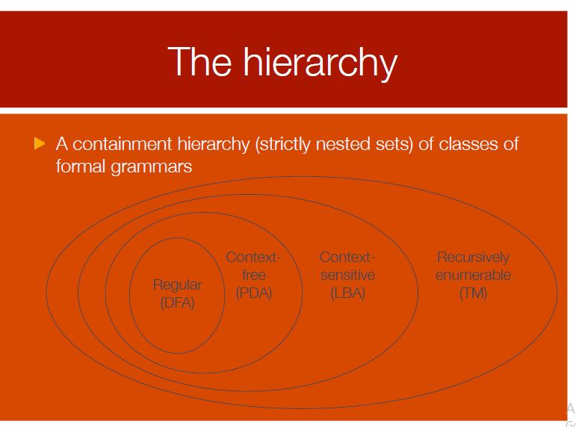

Slide 27
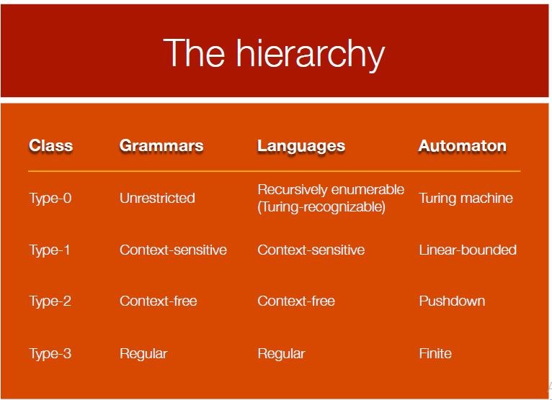

Slide 28
Defining the PSG(Phrase Structure Grammar) Types and Rules for type of productions in these Grammars
Type 0: Phase-structure grammars – no restrictions on the production rules
Type 1: Context-Sensitive PSG:
  All after fragments are either longer than the corresponding before fragments, or empty:
  if b → a, then |b| <= |a| ∨ a = Ꜫ
Type 2: Context-Free PSG:
  All before fragments have length 1 and are nonterminals:
  if b → a, then |b| = 1 (b ∈ N).
Type 3: Regular PSGs:
  All before fragments have length 1 and nonterminals
  All after fragments are either single terminals, or a pair of a terminal followed by a nonterminal.
  if b → a, then a ∈ T ∨ a ∈ TN.

Slide 29
Classifying grammars
Given a grammar, we need to be able to find the smallest class in which it belongs. This can be determined by answering three questions:
Are the left hand sides of all of the productions single non-terminals?
If yes, does each of the productions create at most one non-terminal and is it on the right?
Yes – regular No – context-free
If not, can any of the rules reduce the length of a string of terminals and non-terminals?
Yes – unrestricted No – context-sensitive

Slide 30
A regular grammar is one where each production takes one of the following forms: (where the capital letters are non-terminals and w is a non-empty string of terminals):
S → Λ,
S → w,
S → T,
S → wT.
Therefore, the grammar: S → 0S1, S → λ
is not regular, it is context-free
Only one nonterminal can appear on the right side and it must be at the right end of the right side.
Therefore the productions
A → aBc and S → TU
are not part of a regular grammar,
but the production A → abcA is.

Slide 31
Linear Grammars

Slide 32
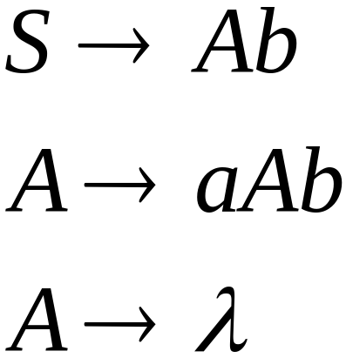
Linear Grammars
Grammars with
at most one variable at the right side
of a production
Examples:

Slide 33

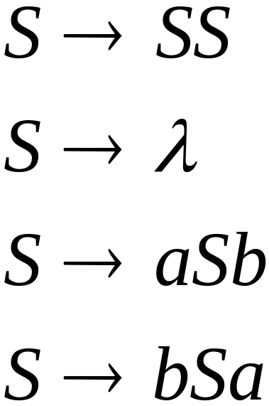
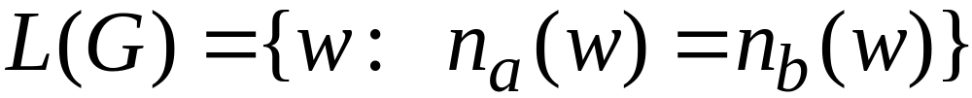
A Non-Linear Grammar
Grammar :

Slide 34
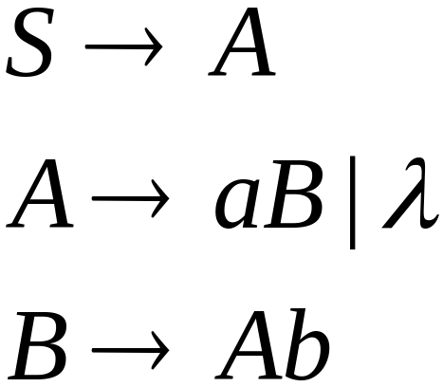
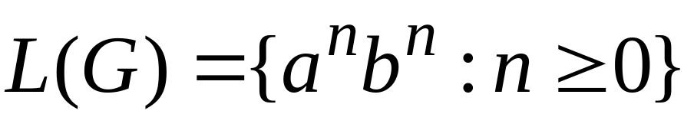
Another Linear Grammar
Grammar :

Slide 35


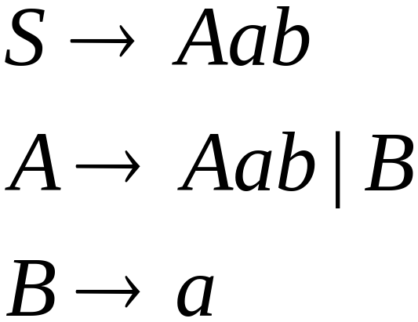
Left-Linear Grammars
All productions have form:
Example:
or

Slide 36

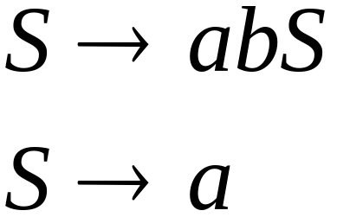
Right-Linear Grammars
All productions have form:
Example:
or

Slide 37

Definition: Context-Free Grammars
Grammar
Vocabulary
Terminal
symbols
Start
variable
Productions of the form:
Non-Terminal
String of variables
and terminals

Slide 38
Derivation Tree of A Context-free Grammar
  Represents the language using an ordered rooted tree.
  Root represents the starting symbol.
  Internal vertices represent the nonterminal symbol that arise in the production.
  Leaves represent the terminal symbols.
  If the production A → w arise in the derivation, where w is a word, the vertex that represents A has as children vertices that represent each symbol in w, in order from left to right.
Notes:
CHAPTER 5
BCT2083 DISCRETE STRUCTURE & APPLICATIONS

Slide 39
Language Generated by a Grammar
Example: Let G = ({S,A,},{a,b}, S,
{S → aA, S → b, A → aa}). What is L(G)?
Easy: We can just draw a tree
of all possible derivations.
  We have: S ⇒ aA ⇒ aaa.
  and S ⇒ b.
Answer: L = {aaa, b}.
S
aA
b
Example of a
derivation tree
or parse tree
or sentence
diagram.
aaa

Slide 40
Example: Derivation Tree
  Let G be a context-free grammar with the productions P = {S →aAB, A →Bba, B →bB, B →c}. The word w = acbabc can be derived from S as follows:
  S ⇒ aAB →a(Bba)B ⇒ acbaB ⇒ acba(bB) ⇒ acbabc
  Thus, the derivation tree is given as follows:
S
a
A
B
B
b
a
b
B
c
c
Notes:
CHAPTER 5
BCT2083 DISCRETE STRUCTURE & APPLICATIONS

Slide 41
Generating Infinite Languages
A simple PSG can easily generate an infinite language.
Example: S → 11S, S → 0 (T = {0,1}).
The derivations are:
  S ⇒ 0
  S ⇒ 11S ⇒ 110
  S ⇒ 11S ⇒ 1111S ⇒ 11110
  and so on…
L = {(11)*0} – the
set of all strings
consisting of some
number of concaten-
ations of 11 with itself,
followed by 0.

Slide 42
Another example
Construct a PSG that generates the language L = {0^{n}1^{n} | n∈N}.
  0 and 1 here represent symbols being concatenated n times, not integers being raised to the nth power.
Solution strategy: Each step of the derivation should preserve the invariant that the number of 0’s = the number of 1’s in the template so far, and all 0’s come before all 1’s.
Solution: S → 0S1, S → λ.

Slide 43
Context-Sensitive Languages
The language { a^{n}b^{n}c^{n} | n ≥ 1} is context-sensitive but not context free.
A grammar for this language is given by:
S → aSBC | aBC
CB → BC
aB → ab
bB → bb
bC → bc
cC → cc
Terminal
and
non-terminal

Slide 44
A derivation from this grammar is:-
S ⇒ aSBC
⇒ aaBCBC (using S → aBC)
⇒ aabCBC (using aB → ab)
⇒ aabBCC (using CB → BC)
⇒ aabbCC (using bB → bb)
⇒ aabbcC (using bC → bc)
⇒ aabbcc (using cC → cc)
which derives a²b²c².

Slide 45
Language Of Grammar-
Language of Grammar is the set of all strings that can be generated from that grammar.
If the language consists of finite number of strings, then it is called as a Finite language.
If the language consists of infinite number of strings, then it is called as an Infinite language.

Slide 46
Example-01:
Consider a grammar G = (V , T , P , S) where-
V = { S }
T = { a , b }
P = { S → aSbS , S → bSaS , S → ∈ }
S = { S }
This grammar generates the strings having equal number of a’s and b’s.
So, Language of this grammar is-
L(G) = { ∈ , ab , ba , aabb , bbaa , abab , baba , …… }
This language consists of infinite number of strings.
Therefore, language of the grammar is infinite.

Slide 47
Consider a grammar G = (V , T , P , S) where-
V = { S , A , B , C }
T = { a , b , c }
P = { S → ABC , A → a , B → b , C → c }
S = { S }
This grammar generates only one string “abc”.
So, Language of this grammar is-
L(G) = { abc }
This language consists of finite number of strings.
Therefore, language of the grammar is finite.

Slide 48
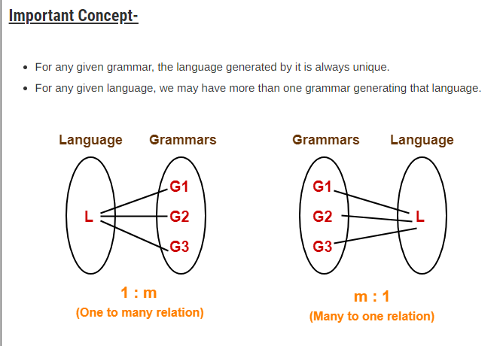

Slide 49
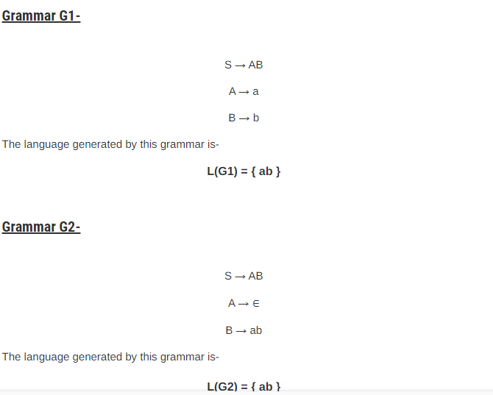

Slide 50
Here,
Both the grammars generate a unique language.
But given a language L(G) = { ab }, we have two different grammars generating that language.
This justifies the above concept.

Slide 52
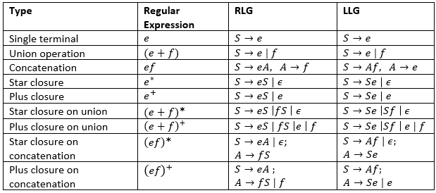

Slide 53
step by step find RLG and LLG for regex 0∗(1(0+1))∗0∗(1(0+1))∗. At each step, same color is used to match part of regex getting translated into corresponding part in grammar.

Slide 54
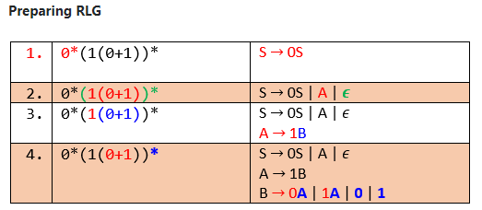

Slide 55
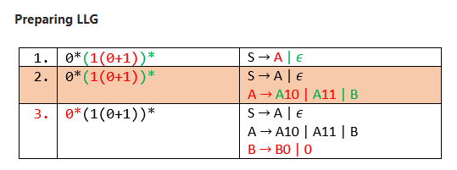

Slide 56
Conversion from RG to FA
Let G = (V, T, P, S) be a regular grammar, where
V = {A0, A1, A2}
T = {0, 1}
S is the start symbol of the grammar.
P is the set of production rules defined as:
A₀ -> 0A₁
A₀ -> 1A₂
A₁ -> 0A₂
A₂ -> 0
Construct a finite-automata that accepts the language generated by a given grammar G.

Slide 57
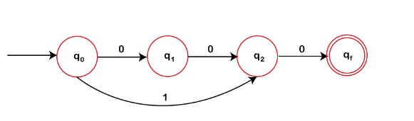

Slide 58
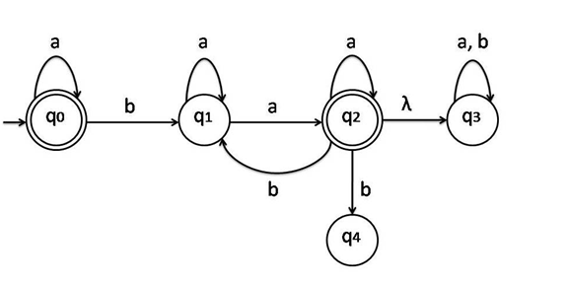
Conversion of RG from given FA

Slide 59
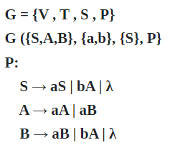
Solution is

Slide 60
Conversion from regular grammar to regular expression
Let A->aA | b
Then it will be a*.b
If it is A->Aa|b then it will be b.a*

Slide 61
EX#1:
S-> 1A | 10 B
A -> 0A | 1
B -> 11B | 0
solution : A= (0)*1 , B= (11)*0
S= 1 (0)*1 +11 (11)*0
EX#2: S-> bB
B -> aB | b B | b
Solution : b.(a+b)*.b

Slide 62
Conversion from R.E to R.G
Method 2: First Convert the given R.E to F.A , then from F.A to R.G
a * .b .(a+b)*
Solution is : S->aS | bA
A-> aA | b A
(Where S = q0 in FA and A is q1 in FA)

Slide 63
Ex#2: (a+ba)* b
RLG : A->aA/bB/bC
B-> aA
C->epsilon
LLG: here final will be start (it will be opposite to RLG)
C->Ab , B-> Ab , A-> Ba/Aa/epsilon

Slide 64
Equivalence of 2 finite automata

Slide 65
Method
The two finite automata (FA) are said to be equivalent if both the automata accept the same set of strings over an input set Σ.
When two FA’s are equivalent then, there is some string x over Σ. On acceptance of that string, if one FA reaches to the final state, the other FA also reaches to the final state.
Method
The method for comparing two FA’s is explained below −
Let M and M1 be the two FA’s and Σ be a set of input strings.
Step 1 − Construct a transition table that has pairwise entries (q, q¹) where q ∈ M and q¹ ∈ M¹ for each input symbol.
Step 2 − If we get in a pair as one final state and other non-final state then we terminate the construction of transition table declaring that two FA’s are not equivalent
Step 3 − The construction of the transition table gets terminated when there is no new pair appearing in the transition table.

Slide 66
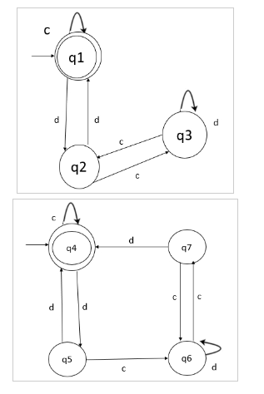

Slide 67
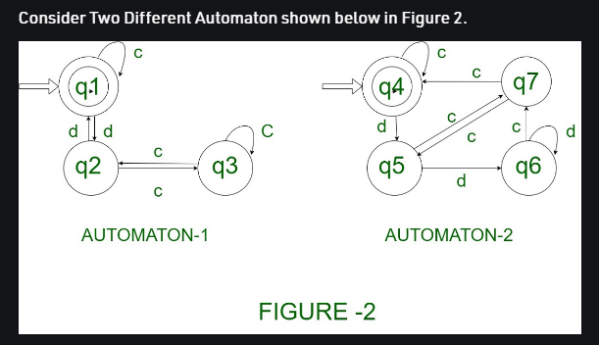


Slide 68
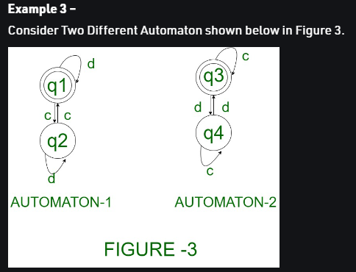

Slide 69
If there is a grammar
G: N = {S, A, B} T = {a, b} P = {S → AB, A → a, B → b}
Find the language of the given grammar

